Slide 1
Team Name Title :
Team Members
: Name1
: Name 2

Slide 2
Problem Addressed
<limited to 500 words>
<Whose problem are you addressing ?>
<What are the specific pain points are you address as a part of the broader problem>?
<your solution – how does it differentiate ?>

Slide 3
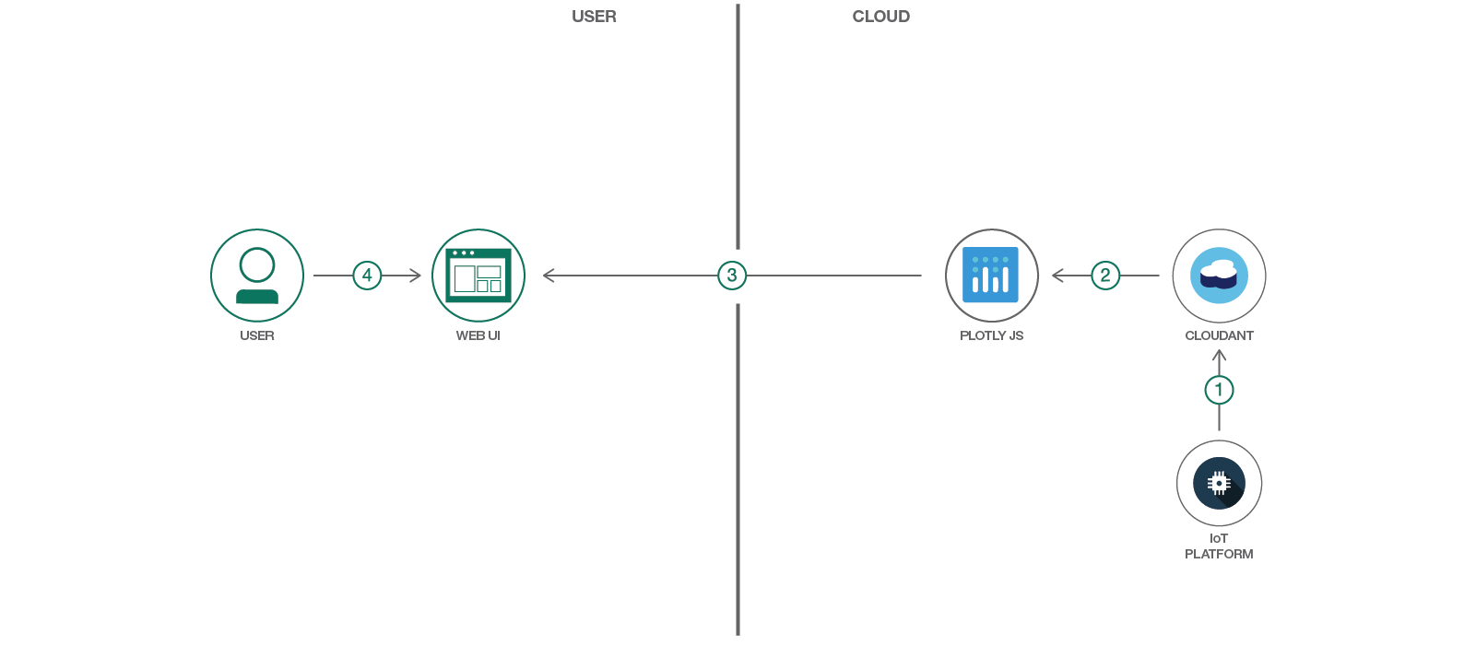
Solution Flow
Draw a flow diagram
E.g

Slide 4
Technology used
<List IBM Cloud Services>
<List any other services >

Slide 5
Demo
If you have working application, demo it now
<make a short video – max 3 mins – preferred >

Slide 6
Future Scope (Road Map)

